Slide 1
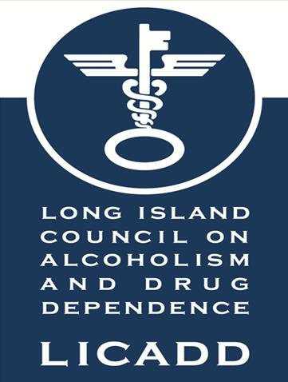
New Trends in Substance Use in the Current Public Health Crisis: Keys to Engaging the Active Substance User
Presented by:
Steve Chassman, LCSW, CASAC
Executive Director
Long Island Council on Alcoholism and Drug Dependence

Slide 2
A National Drug Epidemic
From 1999 to 2014, over half a million Americans died from overdoses of legal or illegal drugs, according to the Centers for Disease Control and Prevention.
The number of annual deaths from narcotics and hallucinogens increased almost threefold during that period, from 11,081 to 32,369.
Deaths resulting from opioid overdoses increased fivefold since 1999, jumping by 17 percent in 2014 alone.
The CDC data also show:
The number of heroin overdose deaths is climbing sharply, more than tripling since 2010.
In 2014, the sharpest increase in deaths, 77 percent, was among people who overdosed on “other synthetic narcotics,” a category that includes opioid painkillers fentanyl, propoxyphene, and meperidine.
Fentanyl led to at least 220 deaths on Long Island in 2016. -Johnny Milano for The New York Times
From 2000 to 2015 more than half a million people died from drug overdoses.
Every day, over 1,000 people are treated in emergency departments for misusing prescription opioids.
91 Americans die every day from an opioid overdose.
-CNN 2017
A new STAT-Harvard poll finds that 41% percent of Americans know someone who has abused prescription painkillers in the last 5 years — and 1 in 12 say they know someone who died from an overdose.
(Natalia Bronshtein (STAT), 2016/ CDC, 2016)

Slide 3
Understanding the Progression
Brief intervention:
Schools, courts, pediatric clinics, emergency rooms, mental health clinics
Brief Interventions
Intensive Treatment
Dependence
Abuse
Early abuse
Infrequent use
Drug Involvement
Abstinence
Adapted from Broadening the Base of Alcohol Treatment (IOM)
Notes:
Treatment options and drug problems are not uni-dimensional concepts. The reality is that there is a range of treatment or intervention options in response to a range of client problems. Specialized or intensive treatment is usually assigned to those individuals at the severe end of a drug involvement spectrum, that is, typically to those who are dependent or addicted to drugs. Brief intervention is most logically indicated when an individual is showing a more mild or moderate version of drug involvement. This is labeled along the drug involvement continuum as early abuse and abuse. Brief intervention techniques can also be used as supplemental therapy within specialized or intensive treatment.
How often or how much would you say these might mean?
Infrequent?
Early use?
Abuse?
Dependence?

Slide 4
Rx New Step in Drug Ladder
heroin, meth, crack
cocaine
shrooms, Ecstasy
Prescription/over-the-counter drugs (Rx/OTC)
liquor, marijuana
AVERAGE AGE OF FIRST USE IS
11-13 YEARS OLD
cigarettes, beer/wine
Notes:
4
Kids normally start on the path to drug use with cigarettes, alcohol and marijuana. Before prescription drug abuse became prevalent, it was a huge jump to go from using those substances to using “harder” drugs like cocaine and heroin. Now, the Rx experience facilitates an easier transition in the progression.

Slide 5
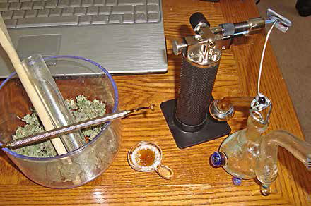
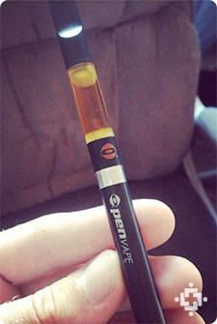
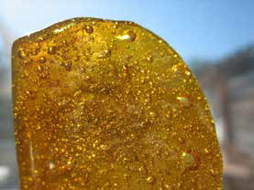
A highly concentrated version of THC known as Butane Hash Oil, Dabs, or Wax is made using highly explosive butane.
Extremely potent; 1-2 drops of oil can equal the amount of 1 joint.
Oil is then put into a Vaporizer, E-cigarette/g-pen, or food.
DABS

Slide 6
Potency
DEA Marijuana Prevention Report 2017

Slide 7
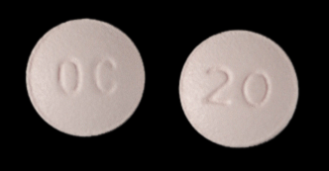
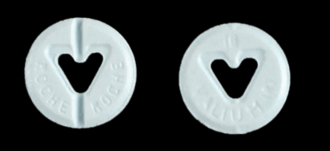
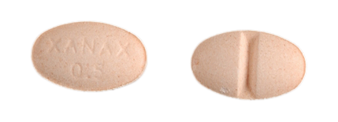
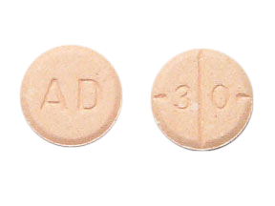
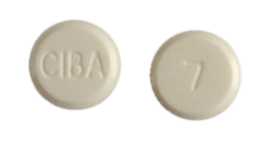
Examples of frequently abused prescription medications
Painkillers
OxyContin®, Vicodin®
Sedatives & tranquilizers
Valium®, Xanax®
Stimulants
Adderall®, Ritalin®
Notes:
Prescription painkillers (e.g., OxyContin and Vicodin), sedatives/tranquilizers (e.g., Valium & Xanax), and stimulants (e.g. Ritalin & Adderall) are most prone to abuse. These drugs are referred to as “controlled substances,” and there are strict prescribing and dispensing regulations for their use. Federal laws prohibit the possession of these drugs without a prescription.
Slang terms used for these drugs include:
OCs’, Oxy80 or Cotton for OxyContin;
Vike, Watson-387 for Vicodin;
Benzos, Tranks for sedatives and tranquilizers;
Uppers, study or smart drugs for stimulants
3. Non-prescription medications can also be abused. Cough and cold preparations are of particular concern. These preparations which contain dextromethorphan (or DXM) can cause intoxication and even hallucinations at high doses. Slang terms in dextromethorphan include Dex, Vitamin D, Robo and Skittles.

Slide 8
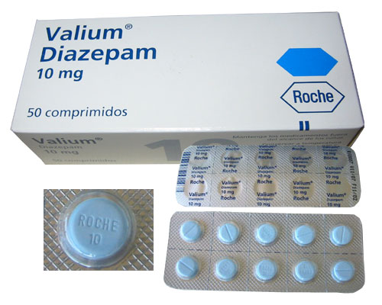
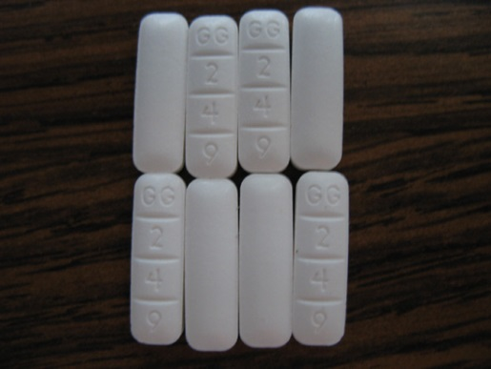
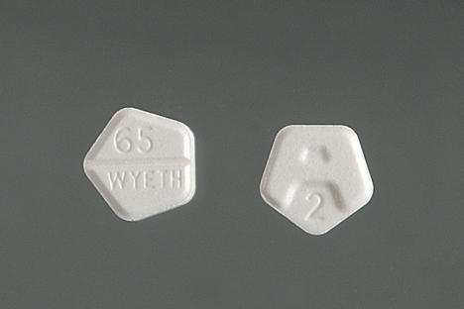
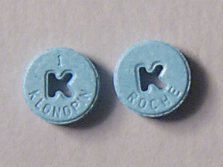
Benzodiazepines
Valium
Xanax
Halcion
Ativan
Klonopin
Common Slang Names
Downers
Benzos

Slide 9
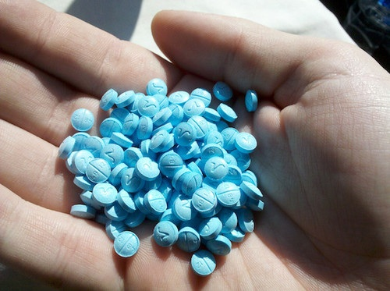
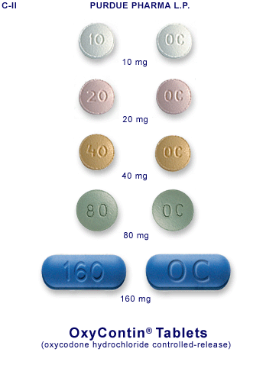
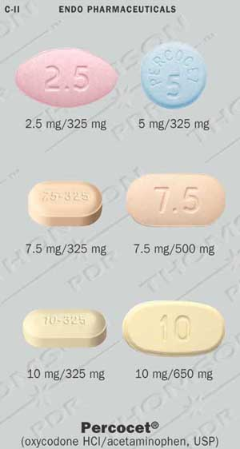
OPIATES
OxyContin
Percodan
Percocet
codeine
methadone
hydrocodone
Vicodin
fentanyl
hydromorphone
Dilaudid

Slide 10
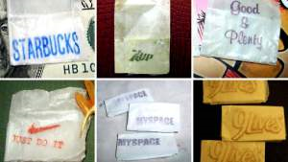
Heroin
A powerful opiate drug.
White or brownish powder, or as the black sticky substance
Can be injected, smoked, or snorted
Physical symptoms of heroin include:
euphoria, drowsiness, respiratory depression, constricted pupils, nausea, and dry mouth
Heroin overdose causes slow and shallow breathing, blue lips and fingernails, clammy skin, convulsions, coma, and can be fatal.
Intravenous use of heroin places individuals at higher risk of diseases like HIV and hepatitis C.
Fentanyl, which looks like heroin, is a powerful synthetic painkiller that has been laced into heroin often without the user’s knowledge.
It is up to 50 times more powerful than heroin and up to 100 times more potent than morphine. A tiny bit can be fatal.
(SAMHSA, 2016)

Slide 11
HEROIN OVERDOSES on Long Island
SUFFOLK COUNTY
2004: 32
2005: 51
2006: 41
2007: 34
2008: 42
2009: 47
2010: 37
2011: 64
2012: 83
2013:100
2014: 86
2015:103
2016: 346
NASSAU
COUNTY
2004: 24
2005: 38
2006: 37
2007: 27
2008: 46
2009: 38
2010: 23
2011: 32
2012: 27
2013: 44
2014: 51
2015: 58
2016: 190
2016
According the county medical examiners reports, in 2016 there were 536 opioid overdose deaths on Long Island, 242 related to fentanyl.
An additional 779 people were revived with Naloxone.

Slide 12
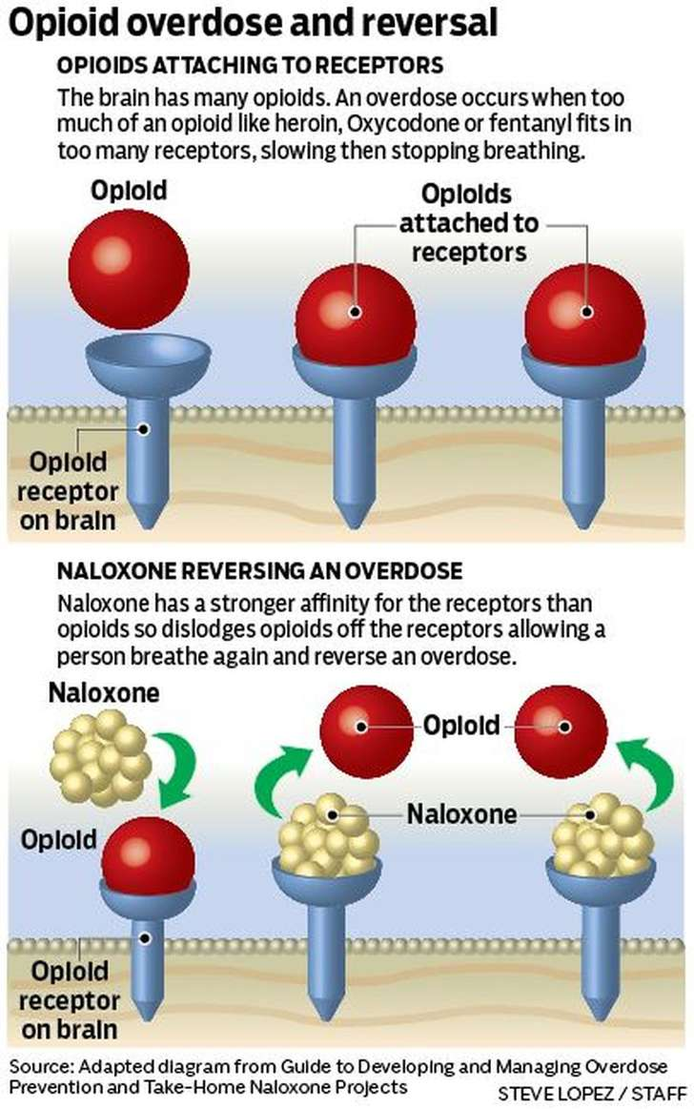
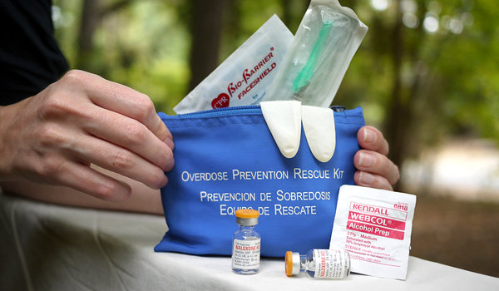
Effect of Narcan
Reverses opiate effect of sedation and respiratory depression
Causes sudden withdrawal in the opioid dependent person – an unpleasant experience
No psychoactive effects – low potential for diversion, is not addictive
Has no effect if an opiate is not present

Slide 13
How do I know if someone is having a problem with drugs or alcohol?
It is important to identify how a persons substance use has lead to changes or dysfunctions in 6 specific life areas,
such as…
Physical/Health
Emotional/Psychological
Interpersonal Relationships (Family/Friends)
Education/Vocation
Financial
Craving

Slide 14
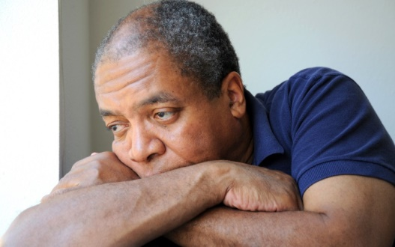
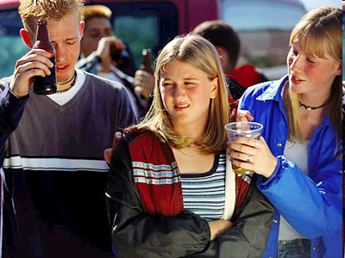
Why Might People Use Drugs?
Curiosity
Peer pressure
Relaxation
Anxiety
Social acceptance
Depression
Escape
Energy
Lose inhibitions

Slide 15
Stages of Change James Prochaska and Carlo DiClemente
relapse
prevention
> motivation
& treatment
treatment
> motivation
treatment
> motivation
& treatment
Notes:
So how do you assess your client’s stage of change? First some background. The principles of stages of change have been described by Prochaska and DiClemente, and these stages are summarized in this pie chart. Each slice of the pie represents a stage of change, and the callout box for each stage indicates the general task for the counselor based upon that respective stage. Let’s look at each individual stage more closely.

Slide 16
Stages of Change (Prochaska and DiClemente)
Pre-Contemplation
Not yet considering possibility of change
Contemplation
Considers change and rejects it
Reason for concern vs. justification for unconcern
Preparation
“I’ve got to do something about this problem.”
“This is serious. Something has to change.”
Action
Maintenance
Identify strategies and support to prevent relapse
Relapse
Help renew contemplation, preparation, action without giving up
Where the Client is At

Slide 17
Motivational Interviewing
Engaging Young People
Client-centered, directive method for enhancing rapport and creating nonjudgmental conversations around intrinsic motivation to change by exploring and resolving ambivalence
Avoid Argumentation
Develop Discrepancy
Roll With Resistance
Express Empathy
Support Self-Efficacy

Slide 18
Coping Skills
Unhealthy Coping Skills
Healthy Coping Skills
Substance Use / Self-Medication
Emotional Eating
Gambling
Over spending
Sexual Obsessions
Feelings of Inadequacies / Low Self-Worth
Anger Management Issues / Rage
Exercise
Communication
(peers, professionals, family, supports)
Relaxation techniques
(meditation, quiet time, spiritual practice, activities of enjoyment)
Mindfulness
Self-expression/Creative expression

Slide 19
LICADD SERVICES
Individual and family counseling
Family support and education
Anger Management/Emotional Regulation Counseling
Relapse Prevention Counseling
Harm Reduction
School-Based Prevention Education
Staff Training
Naloxone Training
Continuing Education for Social Workers and Mental Health Professionals
Community outreach
Advocacy and community partnerships
24-hotline availability
You can reach a LICADD clinician 24/7!
516-747-2606 Westbury
631-979-1700 Holbrook
www.licadd.org

Slide 20
Where to Get Help
Long Island Council on Alcoholism and Drug Dependence, Inc. (LICADD):
www.licadd.org
Executive Office Suffolk Office
1025 Old Country Rd. 1324 Motor Parkway
Suite 221 Suite 102
Westbury, NY 11590 Hauppague, NY 11749
516.747.2606 631.979.1700
516.747. 0714 Fax 631.676.3114 Fax
LICADD 24/7 Hotline 631.979.1700
Interested in Future Trainings?
http://licadd.ezregister.com

